Slide 1
Smbus Utility
Chant.Yu
2018.03.22

Slide 2
Contents
Smbus Introduction and Problem
Solution – Smbus Hierarchy Tree
Back Up – Scan Algorithm

Slide 3
Smbus Introduction and Problem

Slide 4
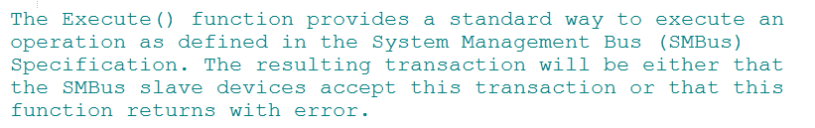
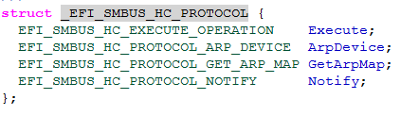
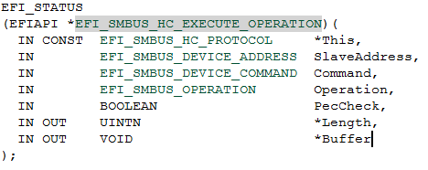
Utilize Smbus Protocol
Step 1
#Include SmbusHc.h // provded by EDKII, based on“PI spec Vol:5”
Step 2
pBS->LocateProtocol ( &gEfiSmbusHcProtocolGuid, NULL, &gSmbusProtocol);
EFI_GUID gEfiSmbusHcProtocolGuid =
{0xe49d33ed, 0x513d, 0x4634, { 0xb6, 0x98, 0x6f, 0x55, 0xaa, 0x75, 0x1c, 0x1b} };

Slide 5
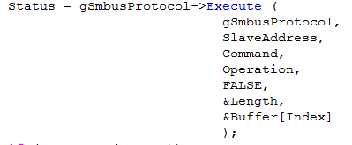
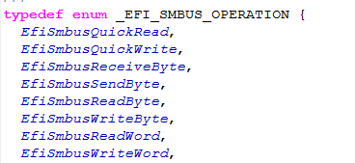
Smbus Read/Write Function
Definition:
P.S. Host operation funciton

Slide 6

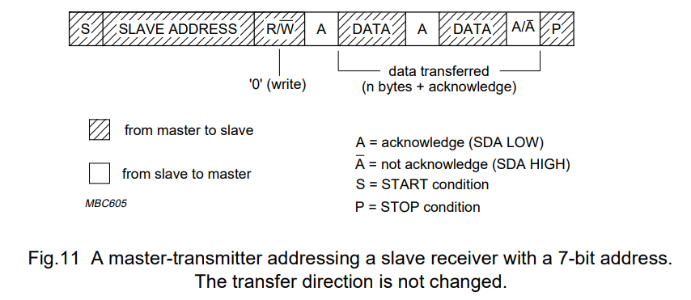
Smbus 7-Bit Address + Read/Write bit
The maximum of slave address to a host (PCH) goes to $2^{7}=$ 128 devices
Make a scan loop
For ( i=0 ; i<0xFF ; i+=2 )

Slide 7
Smbus Scan Function
This method can’t help developer to figure out the nuber of smbus devices on the system, and the scan result may suffer from duplicated address problem…etc

Slide 8
Solution Smbus Hierarchy Tree

Slide 9
Smbus Hierarchy Tree
Like PCI bus, PCI device be managed exclusively by specific Bus:Device:Function, and be identifed by its own Vendor ID and Device ID …etc from configuration space. My Smbus- Hierarchy utility can achieve this goal by scanning in framework of given spec too. With this thought, we are going to create an roadmap, as to Smbus Hierarchy Tree, for smbus host.

Slide 10
Benefit of Smbus Hierarchy Tree
High Compatibility
Smart Navigation
Enhance Efficiency of Development

Slide 11
High Compatibility
There many kinds of smbus devices on the market. Vendor have their rule to manage own devices. Smbus Hierarchy can contain each of them. Reduce asynchronous process. Enhance good Quality.

Slide 12
Smart Navigation
Handle duplicate address and conflict problem. By smart algorithm and External- File, host manage every device precisely. Enhance good Reliability.

Slide 13
Enhance Efficiency of Development
With Smbus Hierarchy function, Developer may systematize the smbus design and develop. Which help team work become more efficiency. Furthermore, reduce period of project process. Create a huge benefit for company!

Slide 14


Core Value
Replace market competition and ruling with a friendly cooperation. Let every one who want to develop smbus feel flexible and convenient.
Less Competition , More Cooperation

Slide 15
External File

Slide 16
Back Up Scan Algorithm

Slide 17
Scan Algorithm - 1

Slide 18
Scan Algorithm - 2

Slide 19
Scan Algorithm - 3

Slide 20
Scan Algorithm - 4

